Slide 1
U.S. Airport & Airline Delay Analysis
Aracely, Luis, Ronak, and Dan

Slide 2
Analysis Summary
Overview: Our project looks to analyze commercial airline flights in the US in order to summarize timeliness of arrivals, and if delayed, the primary reason(s) for this (i.e. weather, carrier, mechanical issues, etc.) including how this varies by both, airline and airport.
We’ve broken up our analysis into two main themes:
Delays by U.S. Airport
Delays by U.S. Airline
Scope: 18 Airlines and the top 25 airports by volume
Time period: September 2018 – September 2019
Data source(s):
United States Department of Transportation, Bureau of Transportation Statistics,
Google Maps (API)

Slide 3
Airport Delay Analysis

Slide 4
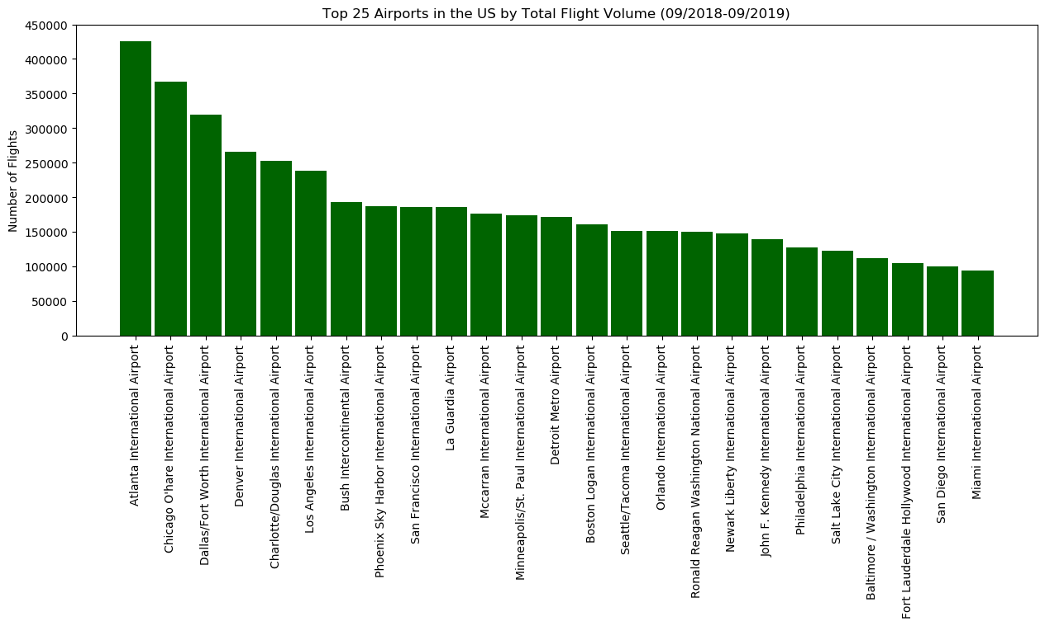

Slide 5
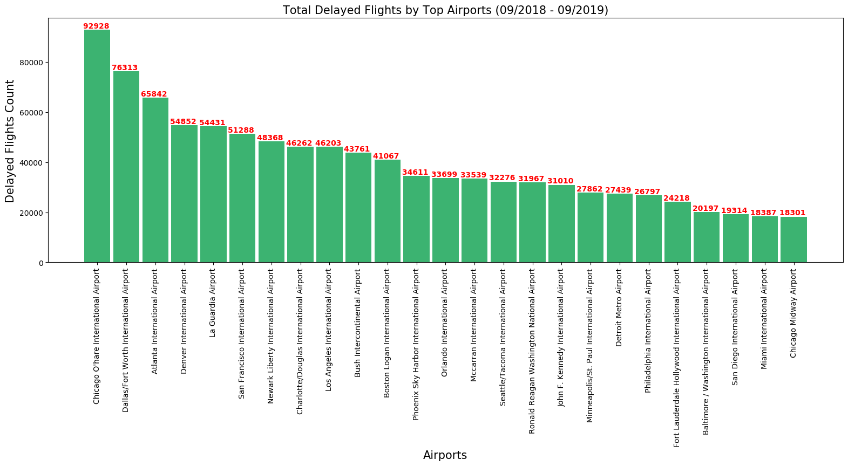

Slide 6
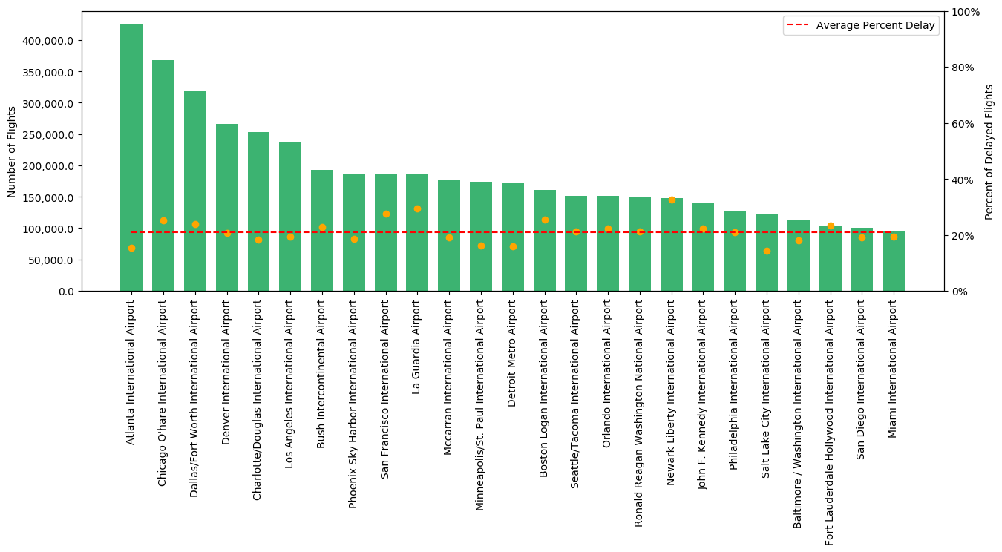
Total number of flights by top 25 U.S. airport including percentage of flight delays for each compared to the mean delay percentage.
Delay percentage

Slide 7
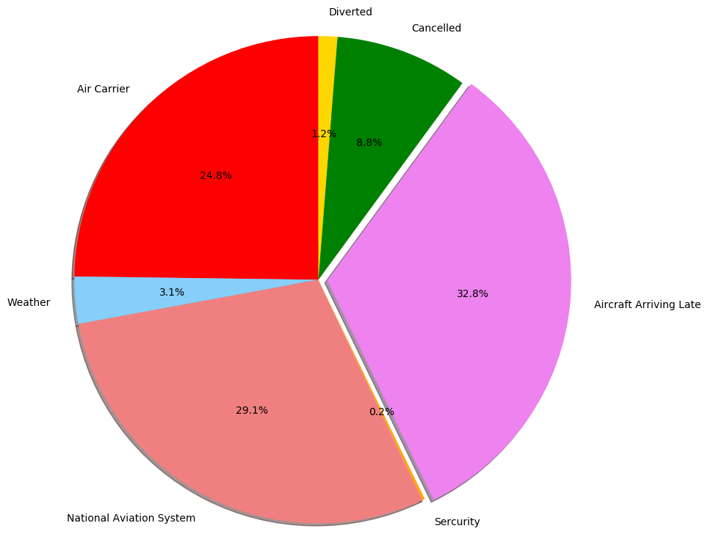
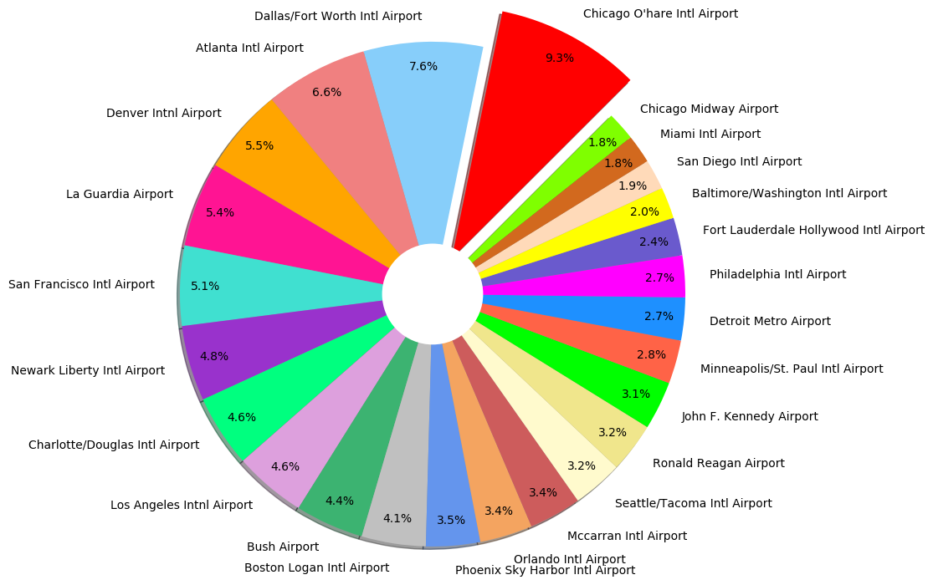
Total Delay Percentage by U.S. Airport
Delay Causes as a Percentage of Total

Slide 8
Airline Delay Analysis

Slide 9
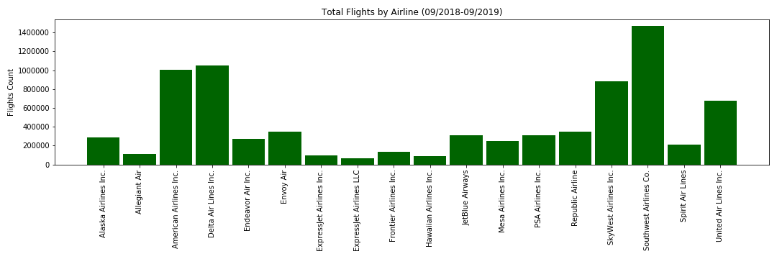

Slide 10
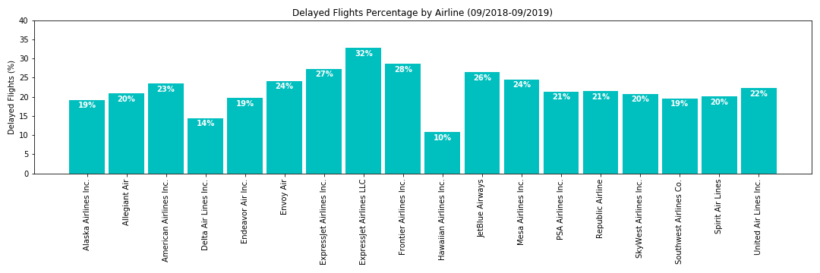
Rank | Airline | Delay Count | Delay Percentage
1 | ExpressJet Airlines LLC (ManaAir)¹ | 21,086.17 | 32.79%
2 | Frontier Airlines Inc. | 39,393.26 | 28.60%
3 | ExpressJet Airlines Inc. (United Airlines)¹ | 26,378.96 | 27.32%
4 | JetBlue Airways | 81,252.91 | 26.39%
5 | Mesa Airlines Inc. | 60,502.04 | 24.59%
6 | Envoy Air (American Airlines)² | 83,714.10 | 24.11%
¹ExpressJet operates as United Express, on behalf of United Airlines. ExpressJet Airlines LLC is majority owned by ManaAir LLC, minority owned by United Airlines. As such, the LLC is synonymous with ManaAir LLC
²Envoy Air operates as American Eagle, a wholly owned subsidiary of American Airlines

Slide 11
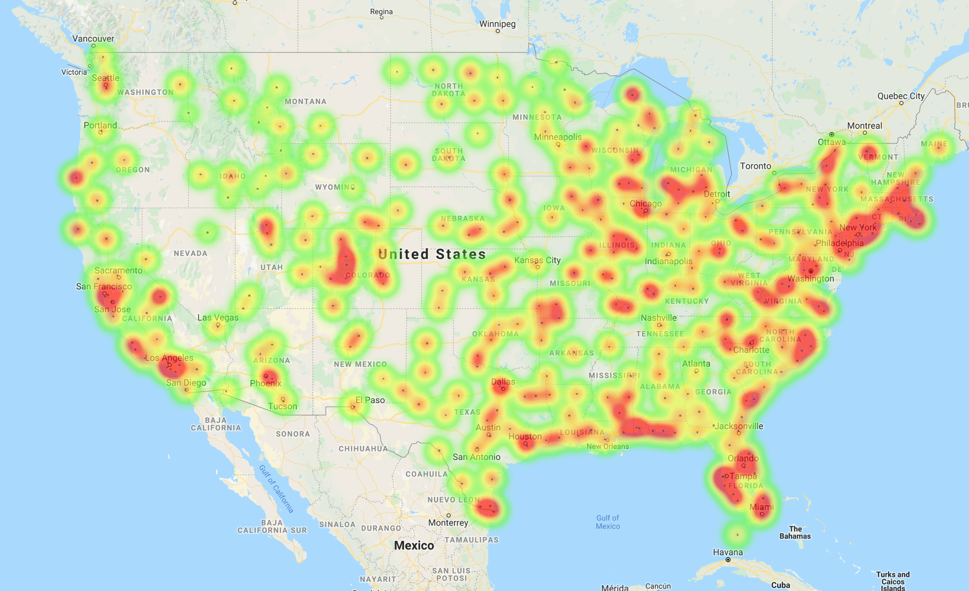
Flight Delay Heatmap – Continental U.S. (all airports)

Slide 12
Appendix – Code Analysis

Slide 13
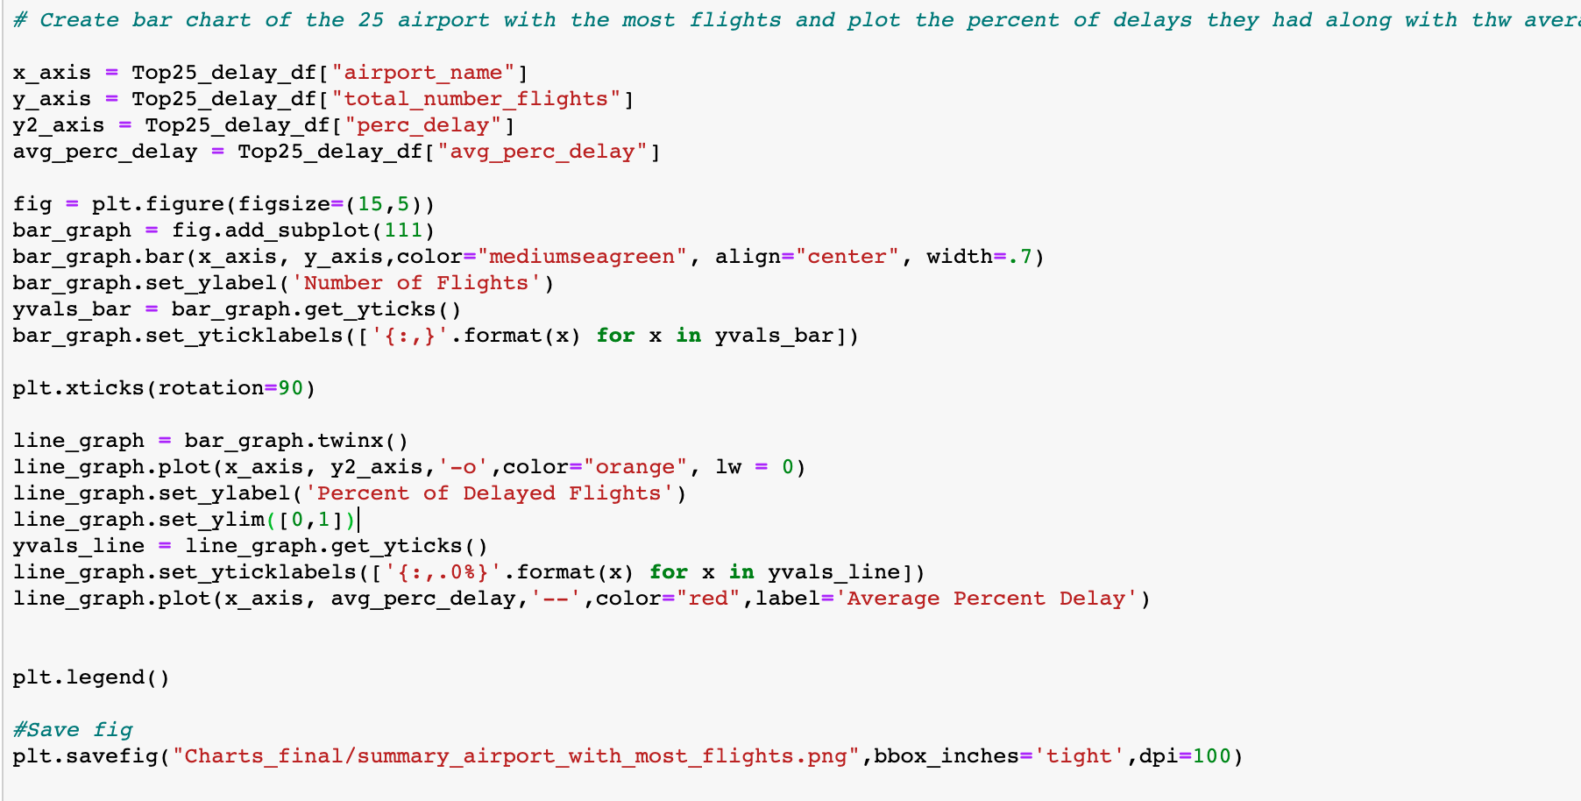

Slide 14
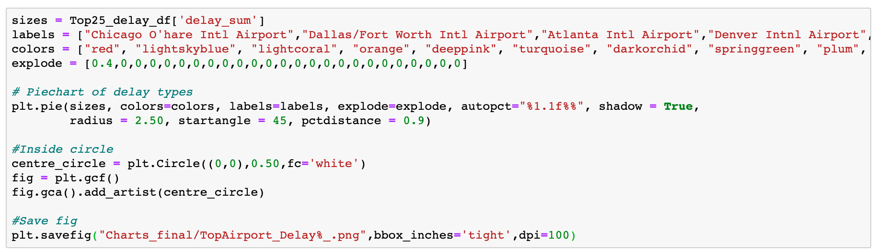

Slide 15
